Slide 1
Day 4
Security Use cases
Presented by: Aditya jamkhande

Slide 2
What is a security usecase
A use case – sometimes referred to as an attack scenario – represents the outcome of an attack, or the attacker’s desired outcome state vis-à-vis a specific asset (or set of assets). This outcome should map to the MITRE ATT&CK Matrix Impact category
Handling such a scenario effectively in a way that mitigates risks and minimizes damage to an organization involves several kinds of preparatory work – including:
Collecting the right security data to perform security analytics
Enriching security alerts for better contextualization
Creating alerts, dashboards & reports for real-time visibility
Orchestrating security monitoring & incident response technologies

Slide 3
Security Devices/Technologies
Firewall
Proxy / Forward proxy
WAF (Web application firewall) – application level logs
Antivirus
EDR
Authentication devices (AAA)
PAM
IDS / IPS
Sandboxes
DLP
CASB
Email gateway appliances
IOT
Cloud endpoints
OS logs

Slide 4
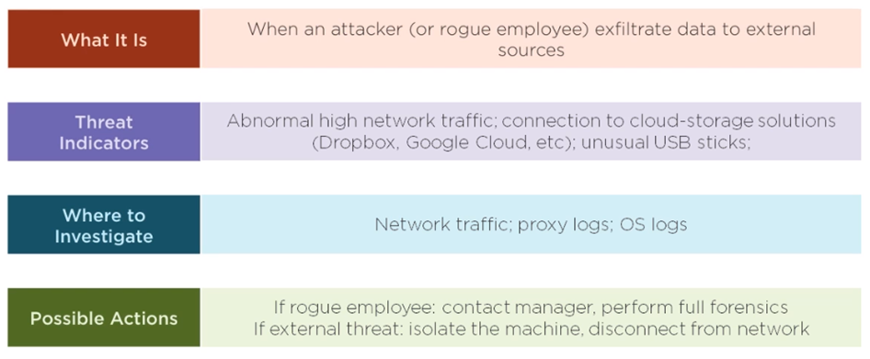
Data exfiltration

Slide 5
Use Case scenario: identify data exfiltration (proxy)
Rule Name | Potential data ex-filtration attempt through proxy
Description | When attacker / insider tries to exfiltrate the data and the attempt is identified via the proxy logs
Threat Indicator | Abnormal traffic - This rule detects if there is an attempt of one GB transfer of the data in a single HTTP request using proxy
Data Source to be investigated | This rule is specifically applicable to proxy data sources like Symantec bluecoat, cisco IronPort, etc.
Possible Pro-active Actions | Network intrusion detection and prevention systems that use network signatures to identify traffic for specific adversary can be used to mitigate activity at the network level.
Possible reactive Actions | Terminate the user session and contact the manager
Tips & Tricks for Security Analyst | Check the source and destination IP associated with this activity Check if the source is infected with a malware Identify the user name / AD user name Contact the user via mail/phone or inform his manager using the organization chart Escalate to L2 / CIRT for further investigation if analysts feel severity is high/insufficient information

Slide 6
Use Case scenario: identify data exfiltration (email)
Rule Name | Potential data ex-filtration attempt through email
Description | This rule detects if there is a transfer of more than15 MB data in a mail through an attachment
Threat Indicator | Abnormal traffic - The leak of sensitive data that might lead the cyber attack/incident in the future or violation of policy/compliance
Data Source to be investigated | This rule is specifically applicable to Email gateway appliance
Possible Pro-active Actions | Use email security systems like the Microsoft Defender for Office 365 to limit the transfer outside organization
Possible reactive Actions | Block the email at the gateway and contact the manager
Tips & Tricks for Security Analyst | Check the Sender email address & Check associated user with email Check recipient email address Check the attachment contents and file Contact the user via mail/phone or inform his manager using the organization chart Escalate to L2 / CIRT for further investigation is analysts feel severity is high/insufficient information

Slide 7
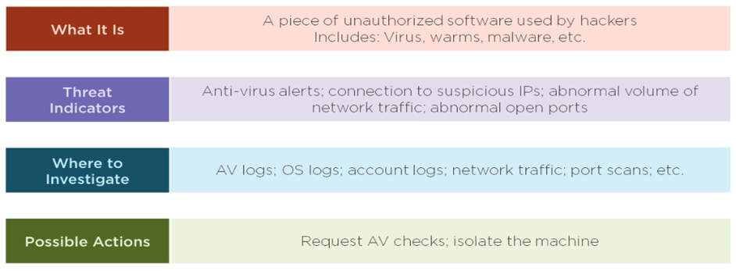
Malware identification

Slide 8
Use Case scenario: identify malware using an edr
Rule Name | Potential malware activity identified
Description | This rule detects if there is a presence of a malware on the endpoint using the AI/ML capabilities of the EDR
Threat Indicator | Monitor for contextual data about a malicious payload, such as compilation times, file hashes, as well as watermarks or other identifiable configuration information
Data Source to be investigated | This rule is specifically applicable to all endpoints (laptops, desktops, servers, cloud based endpoints)
Possible Pro-active Actions | Using the EDR prevention policy to kill the malware at the detection stage
Possible reactive Actions | Quarantining the infected endpoint and performing a deep dive forensics on the machine
Tips & Tricks for Security Analyst | Check the EDR detections for the endpoint Identify the infected files and a cnc connection Check for the lateral movement in the network Verify the actions taken by an EDR (file quarantined and process blocked) Escalate to L2 / CIRT for further investigation is analysts feel severity is high/insufficient information

Slide 9
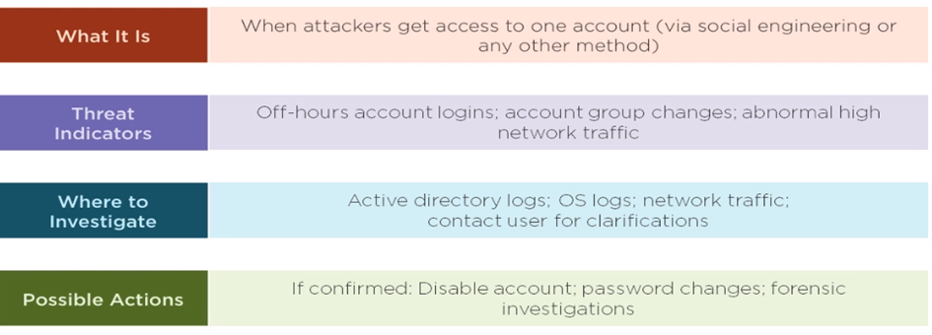
Compromised accounts

Slide 10
Use Case scenario: identify suspicious activity
Rule Name | Audit log cleared on windows system
Description | This rule detects if the audit logs on the endpoint are cleared and the account which performed the activity
Threat Indicator | Monitor executed commands and arguments for actions that would delete Windows event logs (via PowerShell)
Data Source to be investigated | This rule is specifically applicable to all the windows systems
Possible Pro-active Actions | Protect generated event files that are stored locally with proper permissions and authentication and limit opportunities for adversaries to increase privileges by preventing Privilege Escalation opportunities.
Possible reactive Actions | Identify the suspicious activity and the user who performed it
Tips & Tricks for Security Analyst | Check the Client User Name / Account Name associated with this. Identify the user name / AD user name. Contact the User and his / her manager and ask for justification. Contact the user via mail/phone or inform his manager using the organization chart Escalate to L2 / CIRT for further investigation, if analysts feel severity is high/insufficient information. Maybe CIRT will suspend the account until further clarity. Normally CIRT also works for 8 hours but there is somebody always available if needed called Watch duty.

Slide 11
Use Case scenario: identify suspicious activity
Rule Name | Password Changed by someone other than Windows Administrator / Account Owner
Description | Normally Account password is changed by the account owner. But if it reach to an expired period of account password (due to employee on vacation or any other reason), then the employee may request to windows Admin via ticket or call to reset the password.
Threat Indicator | Monitor for suspicious account behavior across systems that share accounts, either user, admin, or service accounts. Examples: one account logged into multiple systems simultaneously; multiple accounts logged into the same machine simultaneously; accounts logged in at odd times or outside of business hours.
Data Source to be investigated | This rule is specifically applicable to all the windows systems
Possible Pro-active Actions | Protect generated event files that are stored locally with proper permissions and authentication and limit opportunities for adversaries to increase privileges by preventing Privilege Escalation opportunities.
Possible reactive Actions | Identify the suspicious activity and the user who performed it and suspend the account
Tips & Tricks for Security Analyst | Check the Client User Name / Account Name associated with this. Identify the user name / AD user name. Contact the User and his / her manager and ask for justification. Contact the user via mail/phone or inform his manager using the organization chart Escalate to L2 / CIRT for further investigation, if analysts feel severity is high/insufficient information. Maybe CIRT will suspend the account until further clarity. Normally CIRT also works for 8 hours but there is somebody always available if needed called Watch duty.

Slide 12
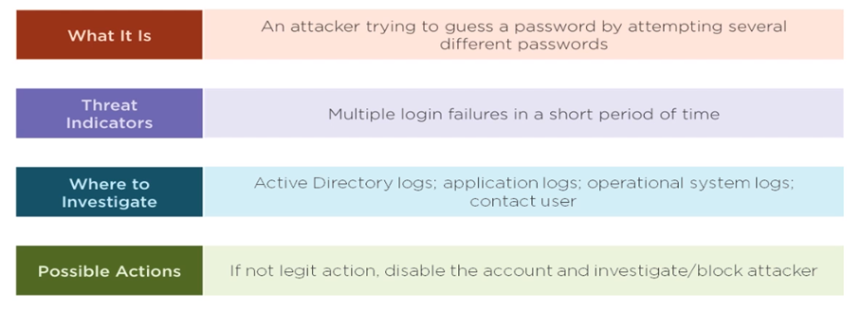
Brute force attack

Slide 13
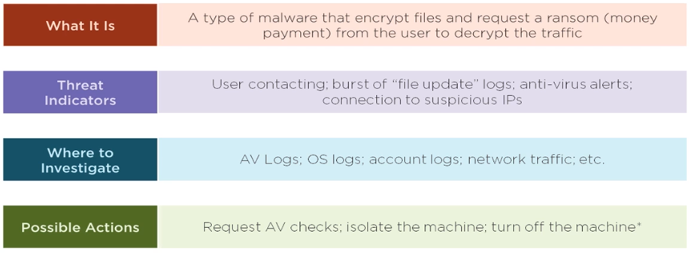
ransomware

Slide 14
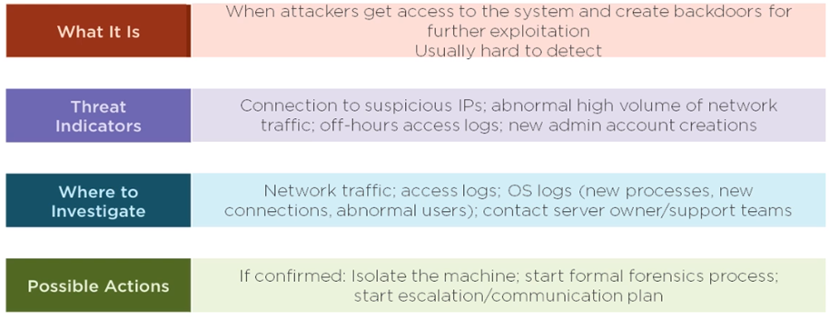
Advanced persistent threats

Slide 15
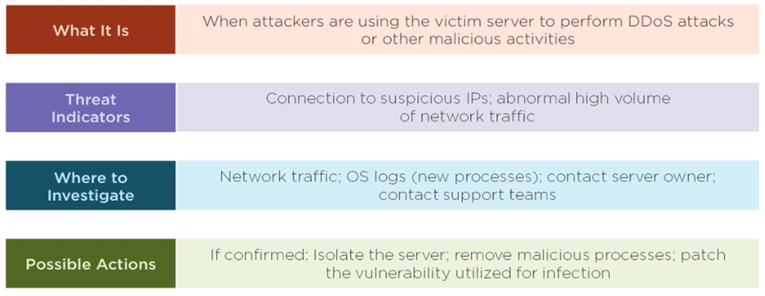
botnets

Slide 16
Denial of service (DOS and DDOS)

Slide 17
Thank you Happy learning !!

